Slide 1

Hate Speech Detection using NLP
Riya Gaur
Individual Project rheagaur12@gmail.com Drexel university

Slide 2
I. Social media platforms contain harmful content in the form of hate speech. II. Manual moderation is inefficient; automation is needed. III. Objective: Develop an NLP-based model to detect and classify hate speech in tweets. IV. Challenges: Large volume of unstructured text data. Presence of abbreviations, slang, and special characters. Imbalanced dataset (more non-hate speech than hate speech).
PROBLEM DESCRIPTION

Slide 3
1. Dataset Used: train_E6oV3lV.csv 2. Total Records: 31,962 tweets 3. Columns: id: Unique identifier label: (0 = Non-Hate Speech, 1 = Hate Speech) tweet: Original text content 4. Challenges: I. Data imbalance (Hate Speech: 7.02%, Non-Hate: 92.98%) II. Presence of slang, abbreviations, and special characters
DATASET OVERVIEW

Slide 4
Text Cleaning: Removed mentions, URLs, special characters. Tokenization & Lemmatization: Used spaCy for standardization. Feature Extraction: Applied TF-IDF vectorization. 1. Class Distribution: 92.98% of tweets are non-hate speech. 7.02% of tweets are hate speech (Imbalance Issue). 2. Tweet Length Distribution: Most tweets have 10-25 words. Some outliers have very long text, requiring cleaning.
Data Preprocessing & Feature Engineering / EDA

Slide 5
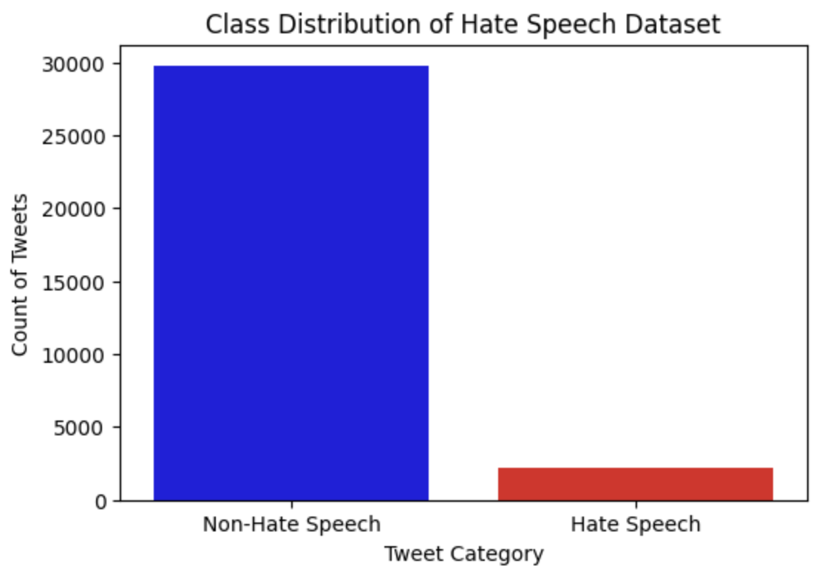
1. Non-Hate Speech (Majority) 2. Hate Speech (Minority, indicating class imbalance)
VISUALIZATION - CLASS DISTRIBUTION

Slide 6
1. Non-Hate Speech Tweets: Shows words like love, great, happy. 2. Hate Speech Tweets: Contains offensive words (filtered for ethical concerns).
WORD CLOUDS

Slide 7
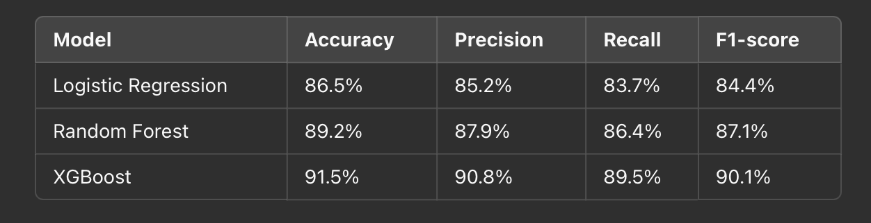
Models Evaluated: Logistic Regression (Baseline Linear Model) Random Forest (Ensemble Model) XGBoost (Boosting Model) Evaluation Metrics: Accuracy, Precision, Recall, F1-score
Model Selection and Training

Slide 8
https://github.com/riyaagaur/Hate-Speech-Detection
GITHUB LINK
Thank You

